Slide 1
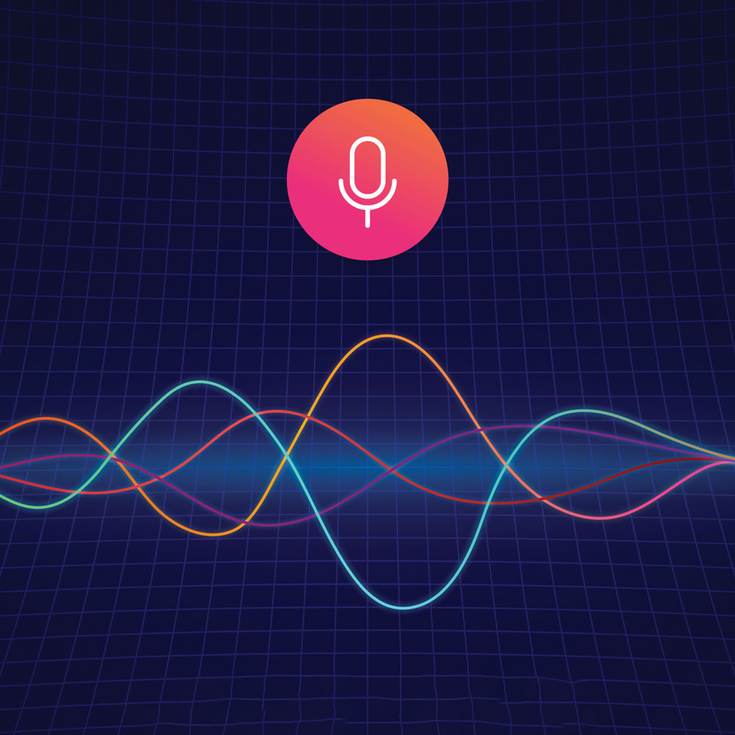
Speech Audio Emotion Recognition
Bella Davies and Roy Chen
Notes:
bella

Slide 2

Problem Statement
Collect speech audio samples and train a neural network to recognize emotion in speech
Many different uses
Identify emotion in voice messages
Movie subtitles
Virtual mental health assistants
Call center analytics
Improving human-computer interaction and responses
Notes:
roy

Slide 3
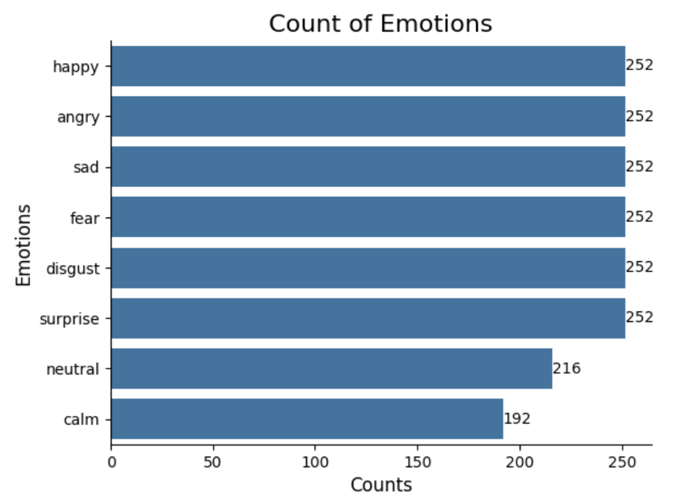
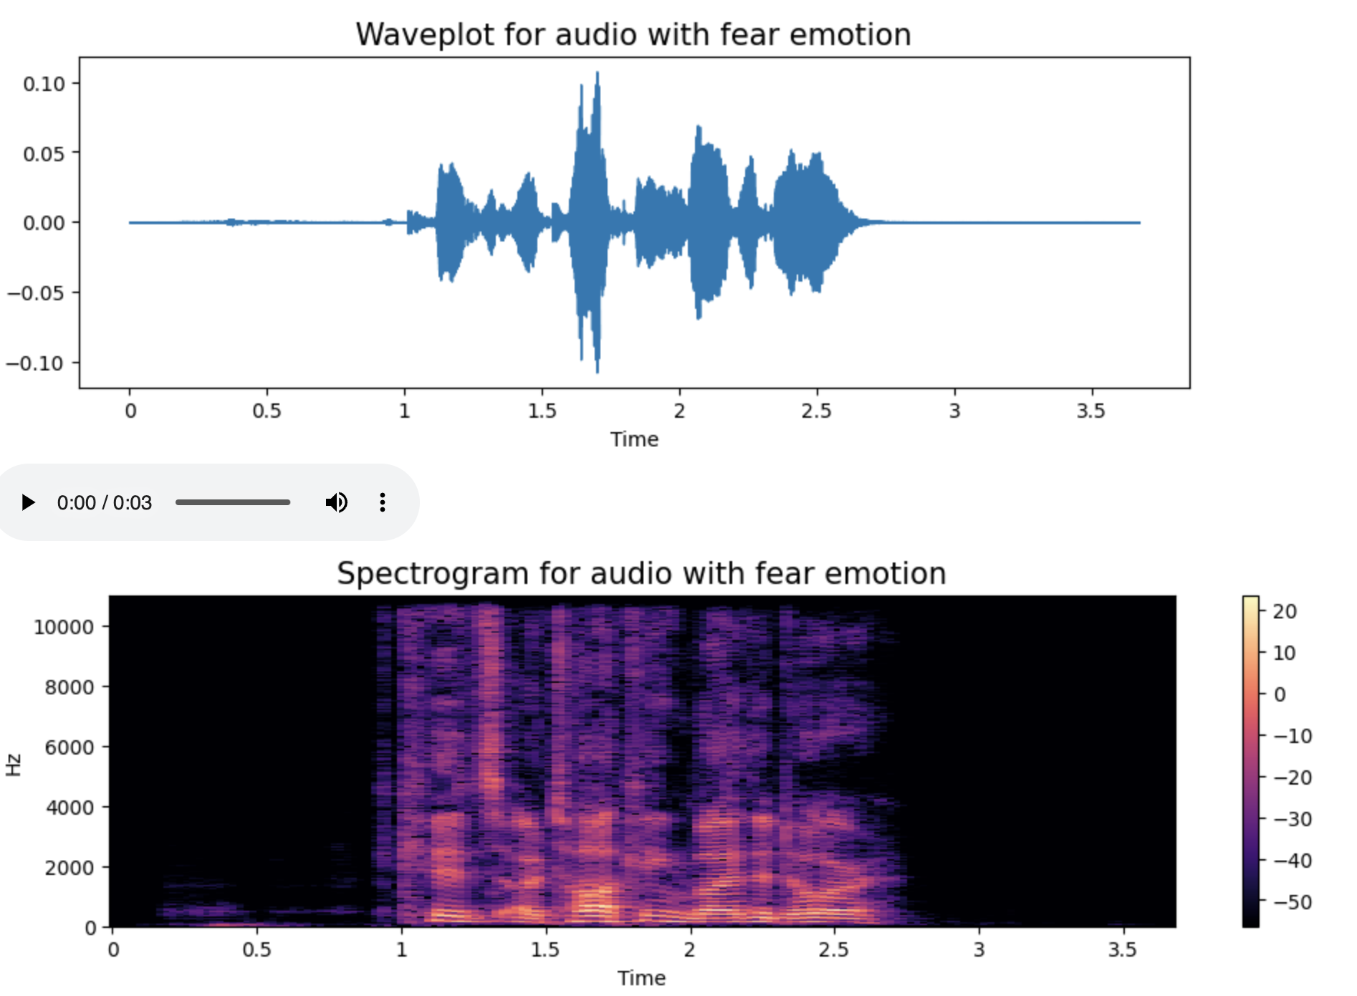
Methods
Getting the Data: (1920 total files with 8 labeled emotions)
Ravdess (1440 audio files)
Savee (480 audio files)
Data Preparation
Data augmentation
Noise, stretch, pitch
Feature Extraction
Visualizations
Modeling/Testing
CNN
CRNN
Notes:
bella

Slide 4
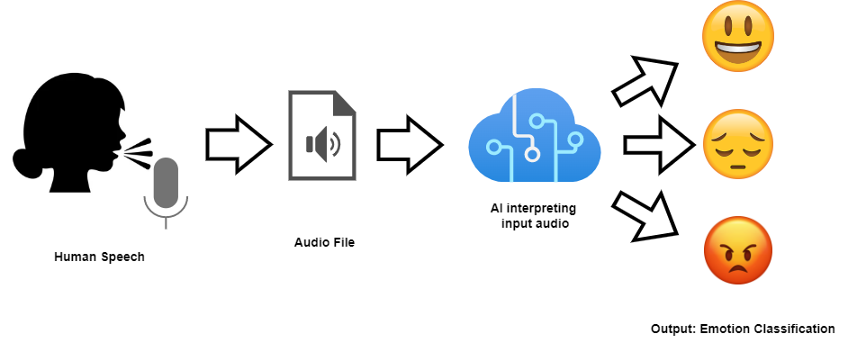
Challenge
Improving our model architecture:
Trying reduced dropout rate of 0.1
Changing number of filters
Adding a convolutional layer
Different activation functions
Gated Recurrent Units
Notes:
roy

Slide 5
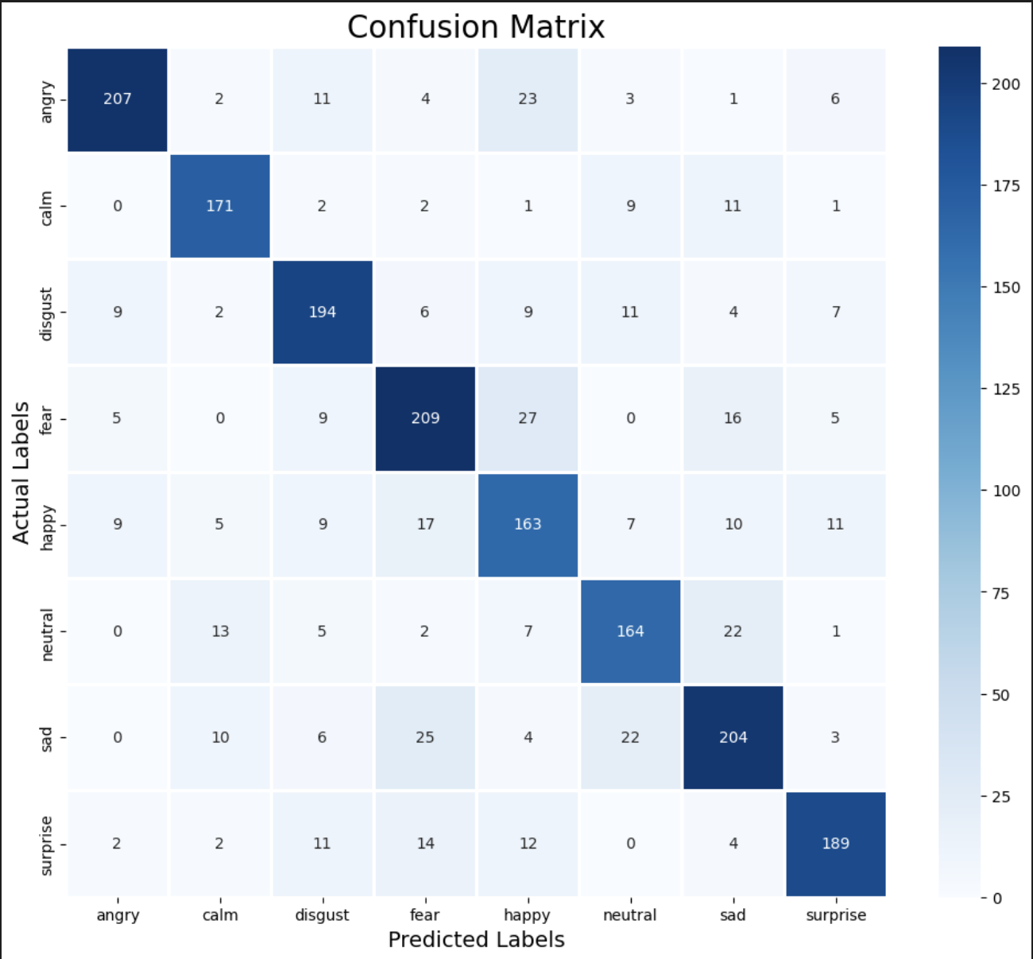
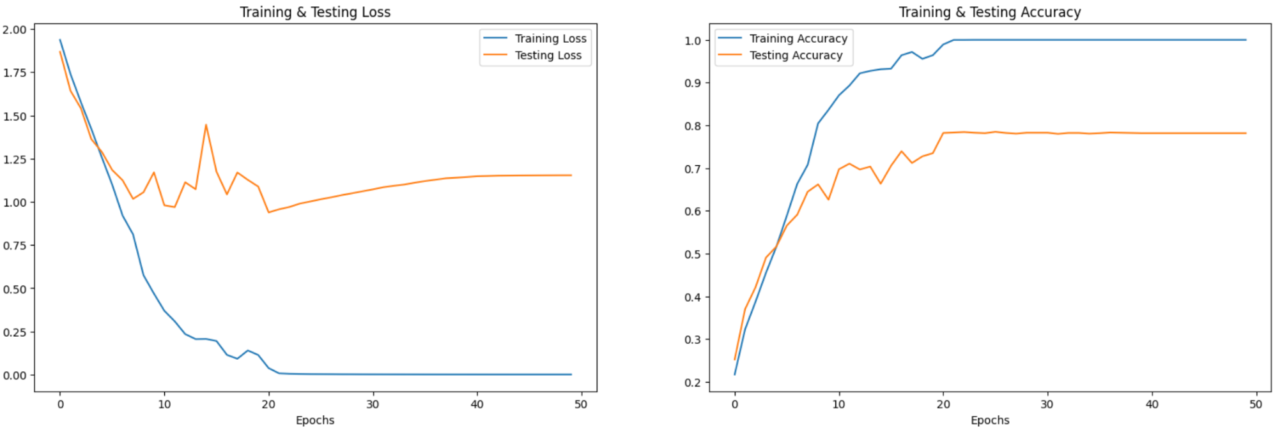
Results
Best Model:
CRNN
4 convolutional layers
4 recurrent layers
Dense layer with softmax activation
0.2 dropout after recurrent layers
78.12% Accuracy
Notes:
bella

Slide 6
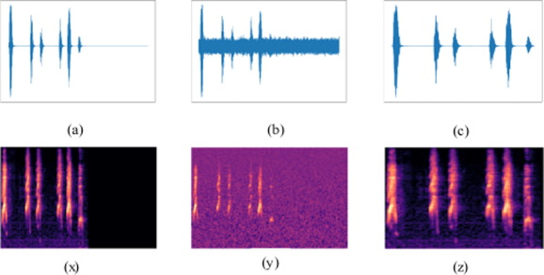
Conclusions
Learning Takeaways
Data augmentation & feature extraction
Wave-plot & spectrogram
Improving model architecture
Notes:
roy

Slide 7

Fun Fact
Testing on clips from Pixar’s Inside Out
Stronger emotions performed better than milder emotions
Notes:
bella

Slide 8
Thank you!

